Slide 1
Mathematical Economics
Lecture 3

Slide 2

Plan
Open and Closed Sets
How to generalize open and closed intervals in $ℝ$ to an abstract metric space?
Limits of Functions

Slide 3





Open and Closed Sets in Metric Spaces
Let ($X,d$) be a metric space. A set $A⊂X$ is open if $∀x∈A ∃ε>0$ s.t. $B_{ε}\left(x\right)⊂A$
(open ball centered at x of radius $ε$ is contained in A).
A set $C⊂X$ is closed if its complement, $C^{c}=X∖C$, is open.
$$ε$$
$$x$$
$$B_{ε}\left(x\right)$$
$$A$$

Slide 4
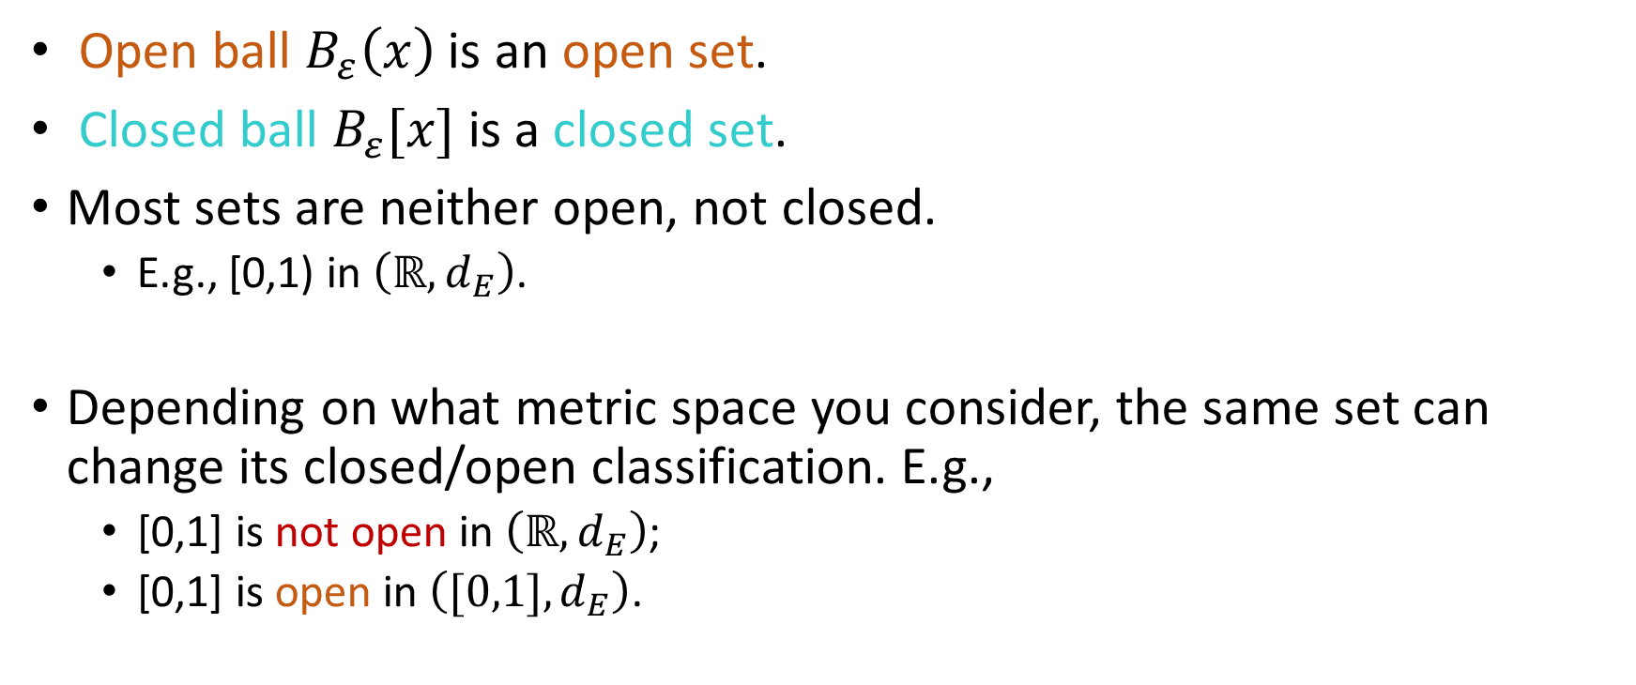
Open and Closed Sets: Examples
Open ball $B_{ε}\left(x\right)$ is an open set.
Closed ball $B_{ε}[x]$ is a closed set.
Most sets are neither open, not closed.
E.g., [0,1) in $\left(ℝ,d_{E}\right)$.
Depending on what metric space you consider, the same set can change its closed/open classification. E.g.,
[0,1] is not open in $\left(ℝ,d_{E}\right)$;
[0,1] is open in $\left([0,1],d_{E}\right)$.

Slide 5
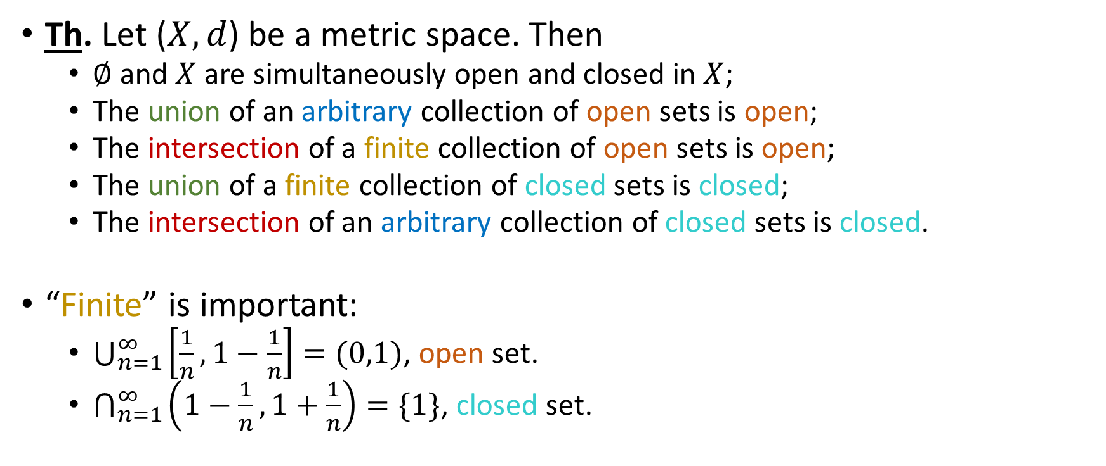
Intersections and Unions of Open/Closed Sets
Th. Let ($X,d$) be a metric space. Then
$∅$ and $X$ are simultaneously open and closed in $X$;
The union of an arbitrary collection of open sets is open;
The intersection of a finite collection of open sets is open;
The union of a finite collection of closed sets is closed;
The intersection of an arbitrary collection of closed sets is closed.
“Finite” is important:
$\bigcup_{n=1}^{∞}{\left[\frac{1}{n}, 1−\frac{1}{n}\right]=(0,1)}$, open set.
$\bigcap_{n=1}^{∞}{\left(1−\frac{1}{n},1+\frac{1}{n}\right)=\{1\}}$, closed set.

Slide 6







Closed Set: Equivalent Definition
Th. A set $A$ in a metric space ($X,d$) is closed if and only if every convergent sequence $\left\{x_{n}\right\}$ contained in $A$ has its limit in $A$.
$$\lim_{}{x_{n}}$$
$$x_{100}$$
$$x_{10}$$
$$x_{2}$$
$$x_{1}$$
$$A$$

Slide 7
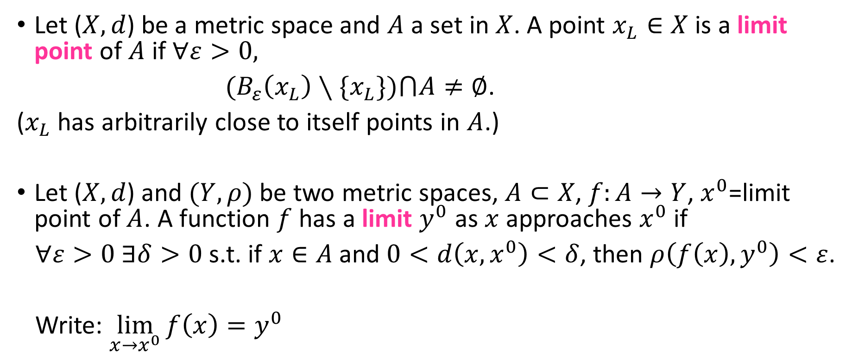
Limits of Functions
Let ($X,d$) be a metric space and $A$ a set in $X$. A point $x_{L}∈X$ is a limit point of $A$ if $∀ε>0,$
${(B}_{ε}\left(x_{L}\right)∖\{x_{L}\})⋂A≠∅$.
($x_{L}$ has arbitrarily close to itself points in $A$.)
Let ($X,d$) and $(Y,ρ)$ be two metric spaces, $A⊂X$, $f:A→Y$, $x^{0}$=limit point of $A$. A function $f$ has a limit $y^{0}$ as $x$ approaches $x^{0}$ if
$∀ε>0 ∃δ>0$ s.t. if $x∈A$ and $0<d\left(x,x^{0}\right)<δ$, then $ρ\left(f\left(x\right),y^{0}\right)<ε$.
Write: $\lim_{x→x^{0}}{f\left(x\right)=y^{0}}$

Slide 8

Limits of Functions: Examples
$f\left(x\right)=\left\{\begin{matrix}x, x≠1; \\ 5, x=1.\end{matrix}\right.$
$\lim_{x→1}{f\left(x\right)=1}≠f\left(1\right).$
The existence and value of the limit depends on values of $f$ near $x^{0}$, but not at $x^{0}$.

Slide 9
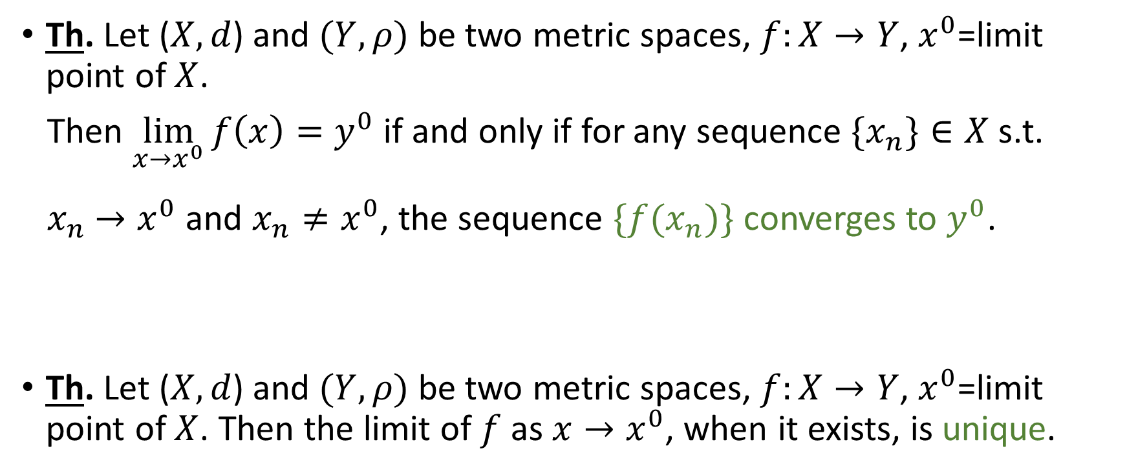
Limits of Functions: Theorems
Th. Let ($X,d$) and $(Y,ρ)$ be two metric spaces, $f:X→Y$, $x^{0}$=limit point of $X$.
Then $\lim_{x→x^{0}}{f\left(x\right)=y^{0}}$ if and only if for any sequence $\{x_{n}\}∈X$ s.t.
$x_{n}$ $→x^{0}$ and $x_{n}≠x^{0}$, the sequence $\{{f(x}_{n})\}$ converges to $y^{0}$.
Th. Let ($X,d$) and $(Y,ρ)$ be two metric spaces, $f:X→Y$, $x^{0}$=limit point of $X$. Then the limit of $f$ as $x→x^{0}$, when it exists, is unique.

